Slide 1
Securing Funding
SE495: Software Entrepreneurship

Slide 2
Outline
Overview
Crafting a Compelling Pitch
Investor Perspectives and Expectations
Due Diligence and Valuation
Incubators and Accelerators

Slide 3
Overview

Slide 4
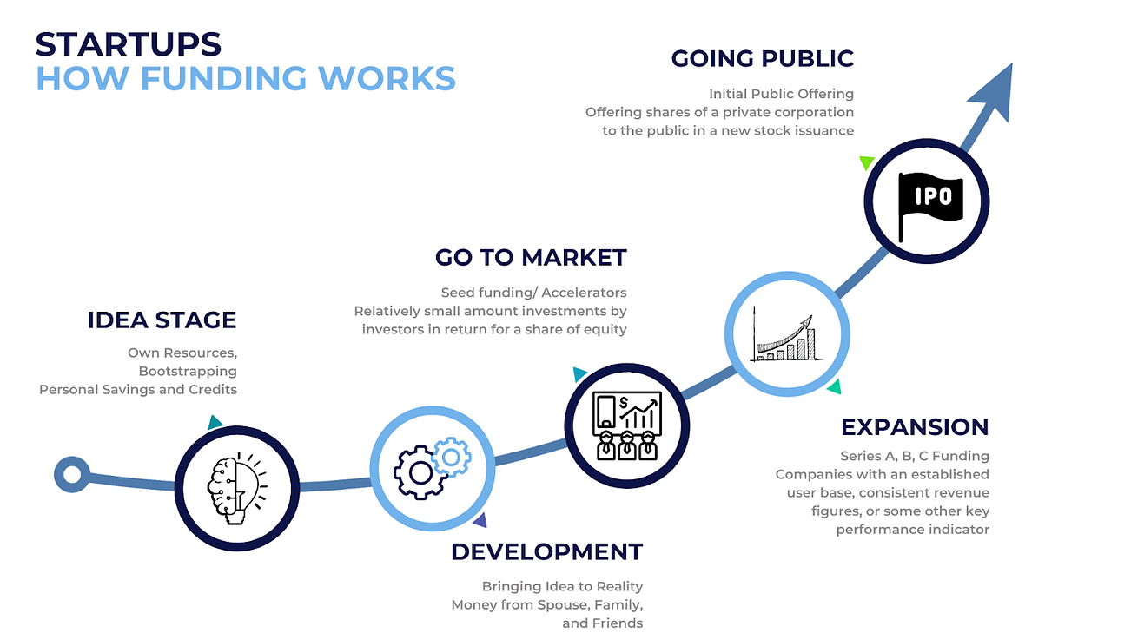

Slide 5
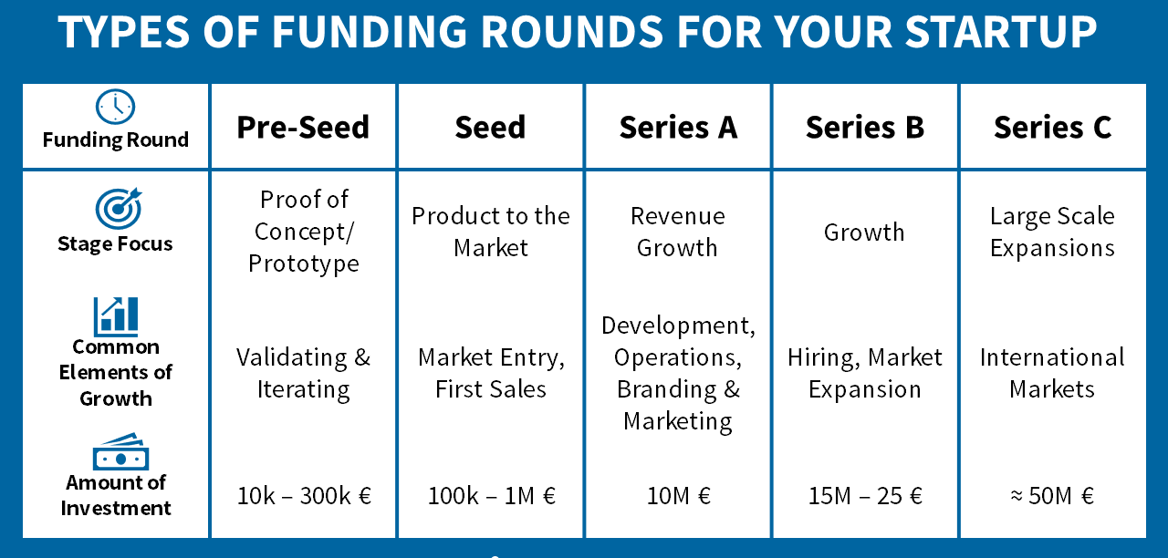

Slide 6
Why?
Software startups need funding to turn their ideas into reality
Funding can help startups hire talent, develop products, and scale operations
Different types of funding options available, each with pros and cons

Slide 7

Introduction to Pitching and Securing Funding
Pitching is the process of presenting a business idea or plan to potential investors or stakeholders to secure funding.
Pitching is crucial for securing funding, as it allows entrepreneurs to showcase their idea, team, and vision to investors, and convince them to invest in their business.

Slide 8

Types of Pitches
Elevator pitch
A brief, 30-second to 1-minute pitch that highlights the key aspects of a business idea, often used in informal settings.
Pitch deck
A visual presentation that summarizes a business idea or plan, typically consisting of 10-20 slides, used in formal pitching sessions.
Other types of pitches:
Executive summary
Business plan

Slide 9
Types of Pitches
The investor pitch
The elevator pitch
The sales pitch
The product pitch

Slide 10

Investor Pitch
An investor pitch occurs in the initial stage of raising money with a potential investor.
Your slide deck should convey your business idea and persuade your investors to invest in your business.
It should also include your business's value proposition, the revenue plan, and a financial breakdown.

Slide 11
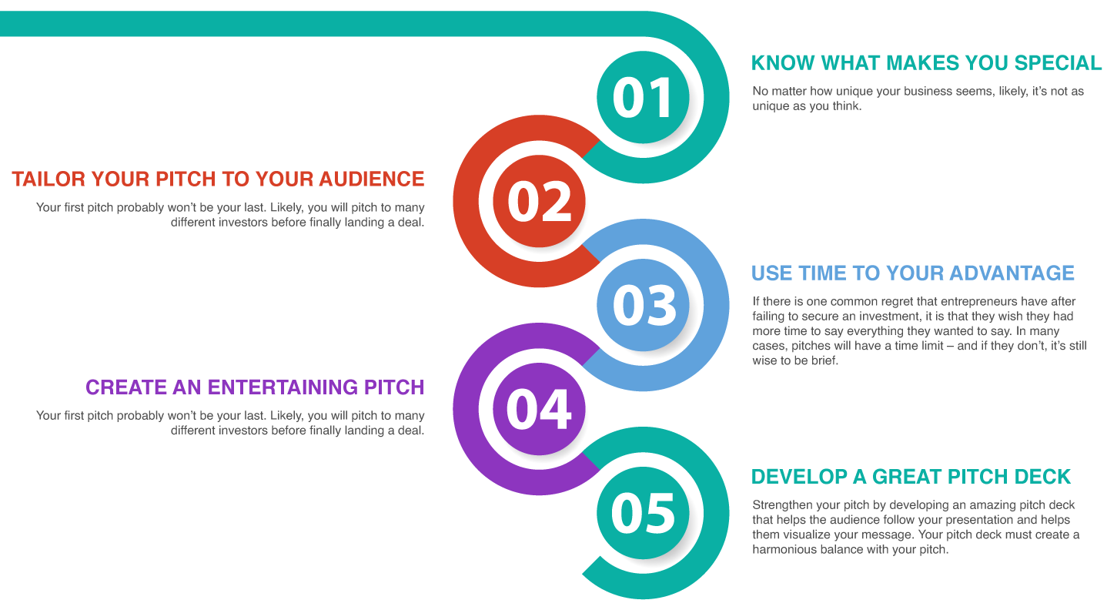
Investor Pitch

Slide 12
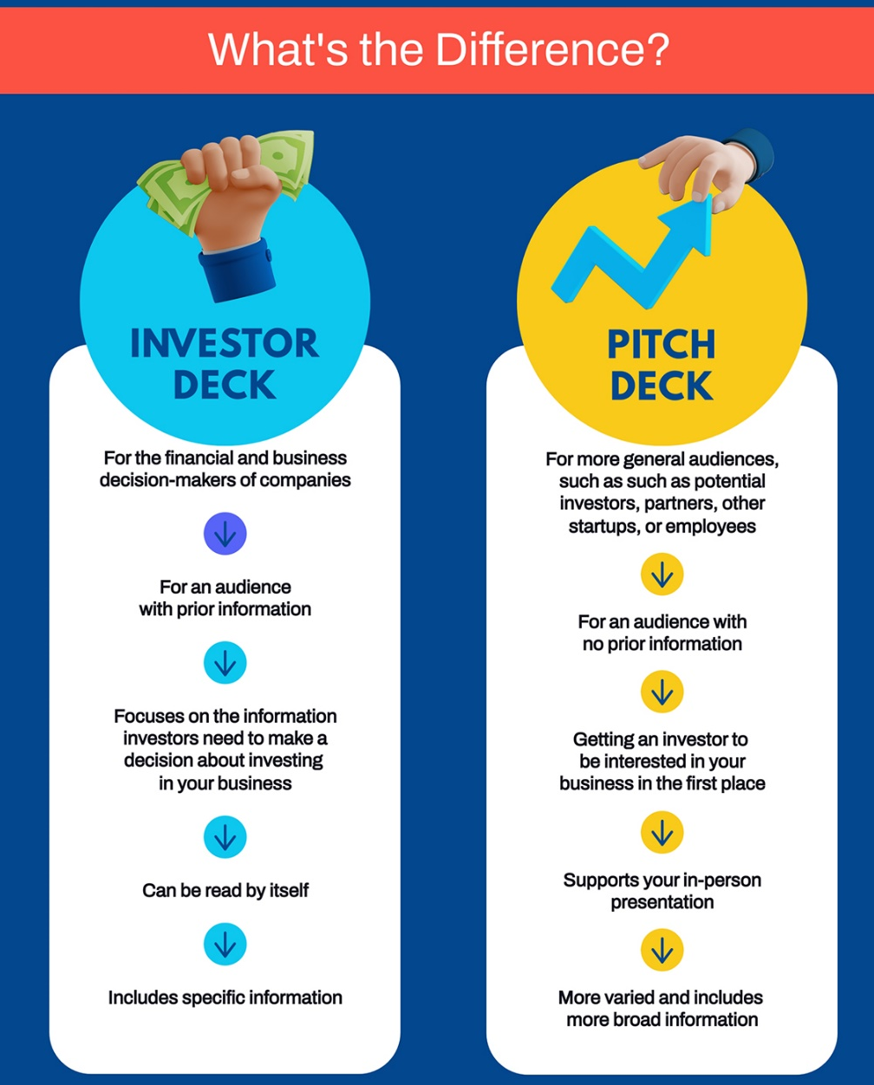
Investor Pitch
Investor deck is a comprehensive presentation.
market analysis, competitive landscape, financial projections, and team management.
A pitch deck is a shorter, more concise version that highlights the key selling points of the business

Slide 13
Elevator pitch
An elevator pitch can be delivered within the duration of an elevator ride.
It's a one-minute session to talk about your business, your product or service, and even your skill sets as an entrepreneur.
This type of pitch must be concise, clear, and persuasive and include a compelling call to action.

Slide 14

Elevator pitch

Slide 15
Sales Pitch
The main objective here is to pitch the value of your product or service to the audience and persuade them to take the desired action.
These pitches may vary in length and style depending on your target audience and objective.
Elements of a sales deck include an introduction to your product or service, a value proposition, business case studies, and a clear call to action.

Slide 16
Product Pitch
This focuses more on a specific product.
A product pitch deck usually contains a brief introduction about the product, the market opportunity, a competitor analysis, and potential revenue.
It should then go into more detail on identifying a problem, introducing your product's features, and explaining how the product will solve your customer's problem.

Slide 17
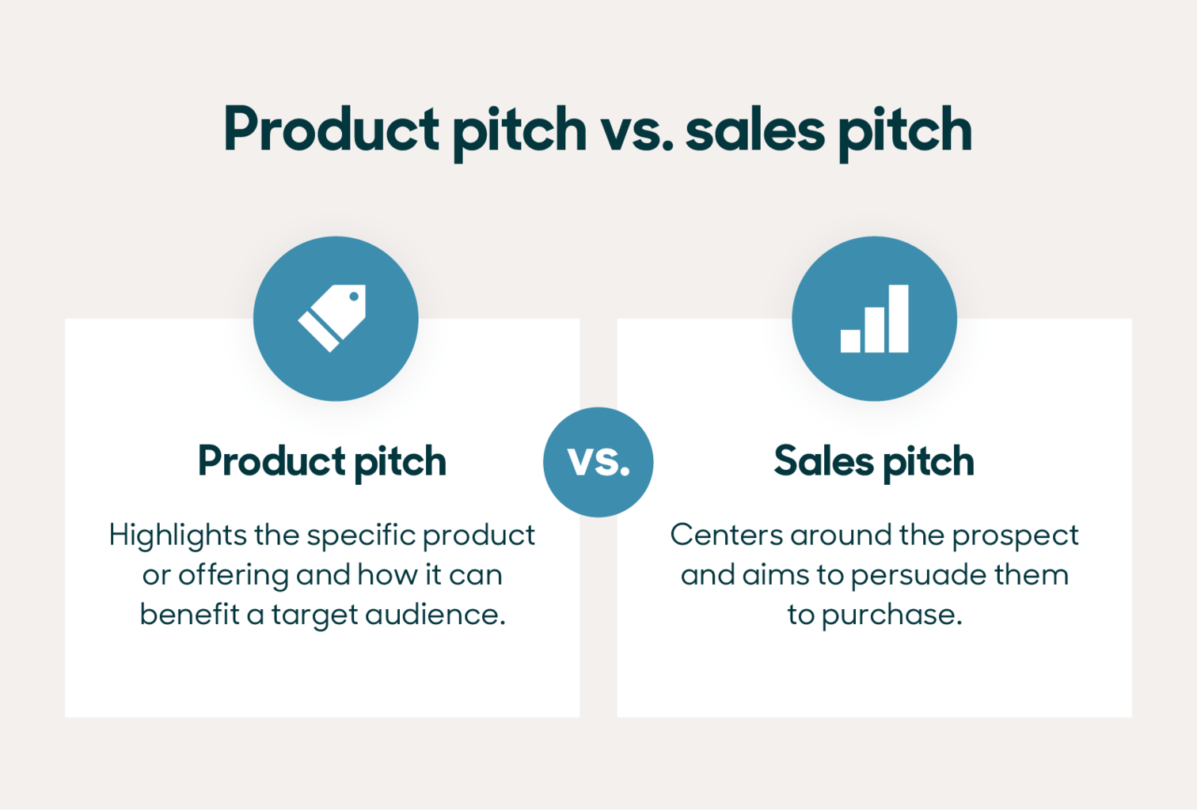

Slide 18

Standing Out from the Crowd
With many startups vying for funding, a compelling pitch is crucial for standing out from the crowd and securing investor interest.
Key elements of a compelling pitch:
Unique value proposition
Strong team
Large market opportunity
Competitive advantage
Clear business model

Slide 19
Research, Practice, and Perfect Your Pitch
Research
Understand the investor's interests, preferences, and criteria for investment.
Practice
Rehearse the pitch to ensure a smooth and confident delivery.
Perfect
Refine the pitch based on feedback from mentors, advisors, and potential investors.

Slide 20
Confidence, Passion, and Storytelling
Confidence
Show confidence in the business idea and team.
Passion
Demonstrate passion for the business and its potential impact.
Storytelling
Use storytelling techniques to engage the audience and make the pitch memorable.

Slide 21
Crafting a Compelling Pitch

Slide 22
Crafting a Compelling Pitch
A pitch is a presentation that entrepreneurs use to convince investors or stakeholders to invest in their business.
A compelling pitch is crucial for securing funding and support for a business.
Problem statement
Solution
Market opportunity
Competitive advantage
Business model
Team

Slide 23
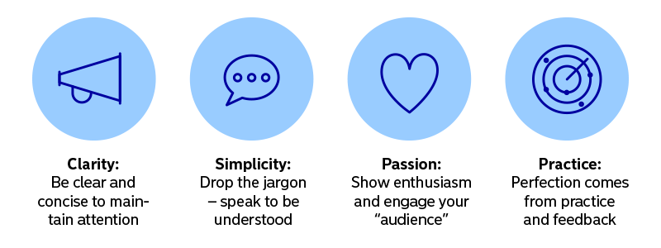
Tips for Creating a Clear and Concise Pitch
Focus on the essentials
Avoid unnecessary details and focus on the key elements of the pitch.
Practice
Rehearse the pitch to ensure a smooth and confident delivery.
Use storytelling techniques
Use anecdotes and examples to make the pitch more engaging and memorable.

Slide 24
Common Mistakes to Avoid in a Pitch
Lack of preparation
Failing to research the investor's interests and preferences.
Poor storytelling
Failing to engage the audience with a compelling narrative.
Overemphasis on technology
Focusing too much on the technical details of the product or service.

Slide 25
Crafting a Compelling Pitch
Understanding Your Audience
Defining Your Value Proposition
Crafting a Captivating Story
Building a Strong Brand
Creating a Compelling Demo
Preparing for Common Questions
Practicing Your Pitch
Delivering a Confident and Effective Pitch

Slide 26
Crafting a Compelling Pitch
Define Your Target Audience
Identify the Key Features and Benefits
Create a Compelling Story
Showcase Your Team's Expertise
Provide Social Proof
Outline Your Business Model
Discuss Your Competitive Advantage
Showcase Your Traction
Provide a Clear Call to Action
Practice and Refine
Develop a Unique Value Proposition (UVP(

Slide 27
Final tips
Be authentic and passionate about the business.
Use visual aids to support the pitch.
Anticipate questions and have a clear call to action.

Slide 28
Investor Perspectives and Expectations

Slide 29

Introduction
Investors are individuals or organizations that provide capital to startups in exchange for equity or other forms of return.
Understanding investor perspectives is crucial for crafting a compelling pitch and securing funding.

Slide 30
Investor Perspectives
Investors are looking for opportunities that offer strong growth potential and returns on their investment.
They want to invest in companies that have a clear and scalable business model, a strong team, and a large addressable market.
Investors also consider the competitive landscape, market trends, and the potential for disruption in the industry.

Slide 31
Investor Expectations
Investors expect a clear and compelling value proposition from the companies they invest in.
They want to see a well-defined market opportunity, a solid business plan, and a detailed financial model.
Investors also expect regular updates and communication from the companies they invest in, as well as a clear path to exit.

Slide 32
Types of Investors and Their Expectations
Friends/Family
Friends and family investors are typically motivated by a personal relationship with the entrepreneur and have a lower risk tolerance.
They expect a lower return on investment and are more focused on supporting the entrepreneur.

Slide 33
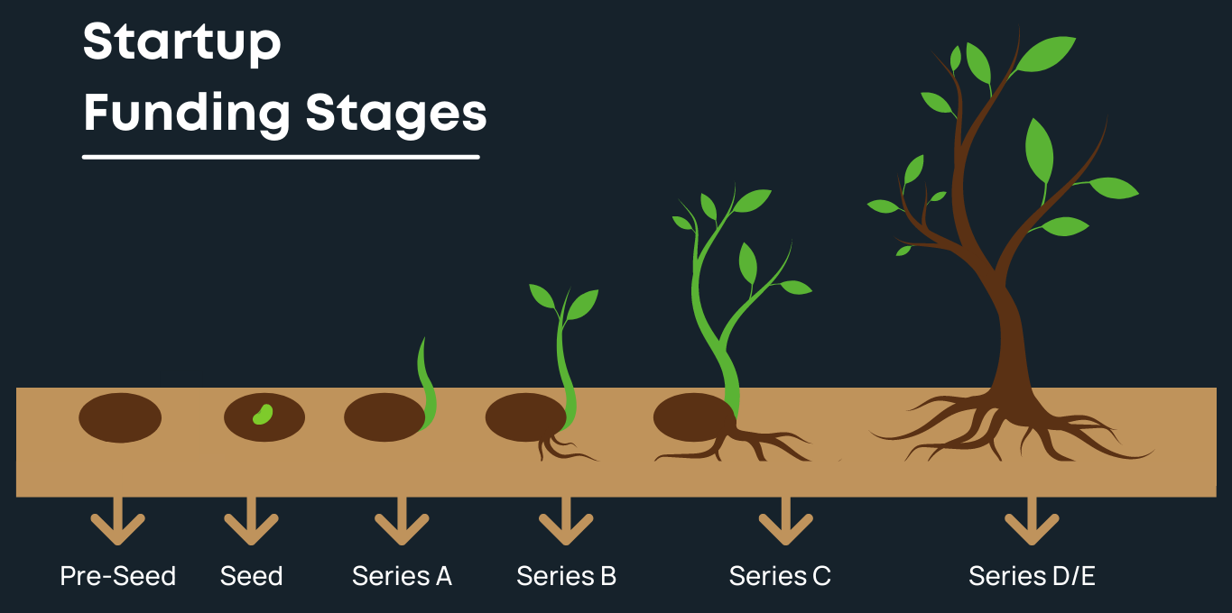
Types of Investors and Their Expectations
Seed Investors
Investors who provide early-stage funding to startups in exchange for equity
Investment goals: Looking for high returns on investment, often with a focus on scalability and growth potential
Investment horizon: Typically 3-5 years
Expectations: Active involvement, regular updates, and a seat on the board

Slide 34

Types of Investors and Their Expectations
Angels:
Angel investors are typically high net worth individuals who invest their own personal capital in startups in exchange for equity.
They have a higher risk tolerance than friends/family investors and expect a higher return on investment.

Slide 35
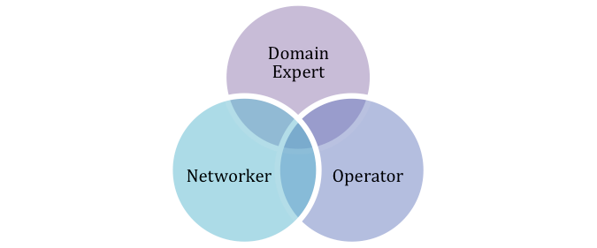
Types of Investors and Their Expectations
VCs
Venture capitalists (VCs) invest capital in startups in exchange for equity and take an active role in the company's growth.
They have a high risk tolerance and expect a significant return on investment.

Slide 36
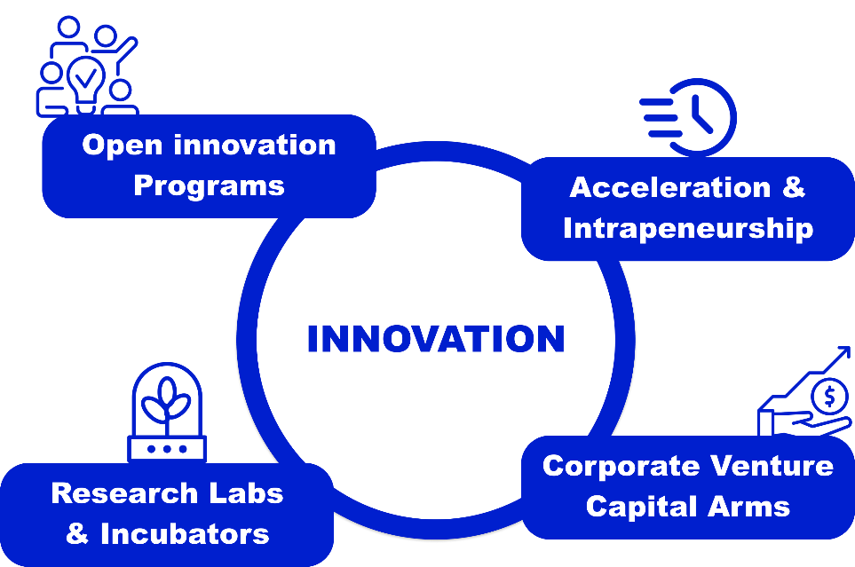
Types of Investors and Their Expectations
Venture Building: Creating Startups from Scratch
A process of creating startups from scratch, often by a team of entrepreneurs, investors, or innovation experts
It involves identifying market opportunities, developing business ideas, and building teams to execute them
Venture builders provide resources, support, and guidance to help startups grow and succeed
Examples of venture builders include startup studios, accelerators, and incubators

Slide 37
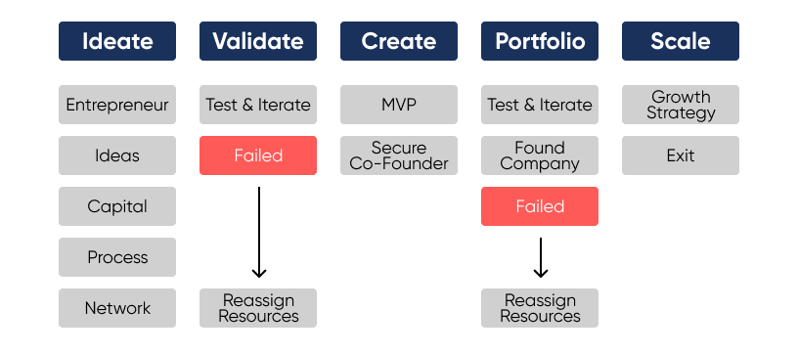
Types of Investors and Their Expectations
Venture Building: Creating Startups from Scratch

Slide 38

Importance of Understanding Investor Perspectives
Understanding investor perspectives helps entrepreneurs tailor their pitch to the specific investor.
A well-crafted pitch that addresses investor concerns can increase the chances of securing funding.

Slide 39
Meets Investor Expectations
Focus on the problem the startup is solving and the solution it offers.
Highlight the market opportunity and the startup's competitive advantage.
Emphasize the team's relevant skills and experience.

Slide 40
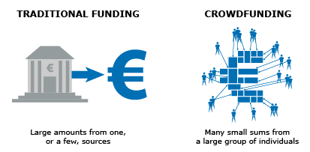
Crowdfunding
A method of raising capital through small contributions from a large number of people, typically through an online platform.
Crowdfunding can provide valuable marketing and exposure for a startup, and it can help entrepreneurs validate their idea and build a community of supporters.
Crowdfunding may not provide enough capital to meet a startup's needs, and it can be time-consuming and resource-intensive.

Slide 41
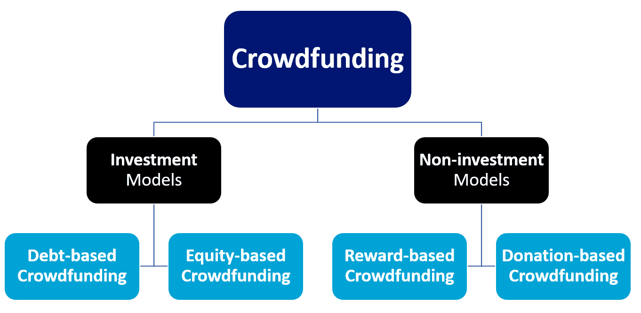
Crowdfunding

Slide 42
Key Metrics for Evaluating Software Startups
User acquisition cost (UAC)
Churn rate
Lifetime value (LTV)
Customer acquisition cost (CAC)
Retention rate

Slide 43
Assessing Growth and Scalability
Market opportunity and potential for growth
Competitive landscape
Market size and growth rate
Scalability of the product and business model

Slide 44
Evaluating the Team
Team dynamics and chemistry
Experience and skills of the founding team
Ability to execute and drive growth
Leadership and vision

Slide 45
Evaluating the Product and Technology
Product-market fit
Scalability and defensibility
Technical capabilities and potential
Competitive advantage

Slide 46
Market Opportunity
Market size and growth rate
Competitive landscape
Target market and customer needs
Market trends and potential for disruption

Slide 47
Investor Perspectives on Product and Technology
How investors evaluate the product and technology
Importance of product-market fit, scalability, and defensibility
Use of technical assessments and due diligence to evaluate the startup's product

Slide 48
Investor Perspectives on the Team
How investors evaluate the team behind a software startup
Importance of team dynamics, experience, and skills
Use of reference checks and interviews to assess the team's ability to execute and drive growth

Slide 49
Tips
Research the investor's interests and preferences before crafting a pitch.
Use storytelling techniques to engage the investor and make the pitch more memorable.
Anticipate questions and have a clear call to action.

Slide 50
Tips for Working with Investors
Be transparent and honest
Set clear expectations
Build relationships
Be responsive
Focus on growth

Slide 51
Common Mistakes to Avoid
Not doing your research
Overvaluing your business
Not having a clear plan
Not communicating effectively
Not being prepared

Slide 52
Due Diligence and Valuation

Slide 53
Due Diligence Process
Due diligence is the process of conducting a thorough examination of a business or investment opportunity to confirm all facts and assess its potential for growth.
Due diligence is crucial for investors to make informed decisions and for entrepreneurs to secure funding.

Slide 54
Key Items to Include in a Due Diligence Package
Business plan
A comprehensive plan outlining the business model, market opportunity, competitive landscape, and growth strategy.
Financial projections
Detailed financial statements, including income statements, balance sheets, and cash flow statements.
Market research
Analysis of the target market, including size, growth potential, and trends.
Legal documents
Copies of all relevant legal documents, such as contracts, patents, and trademarks.

Slide 55
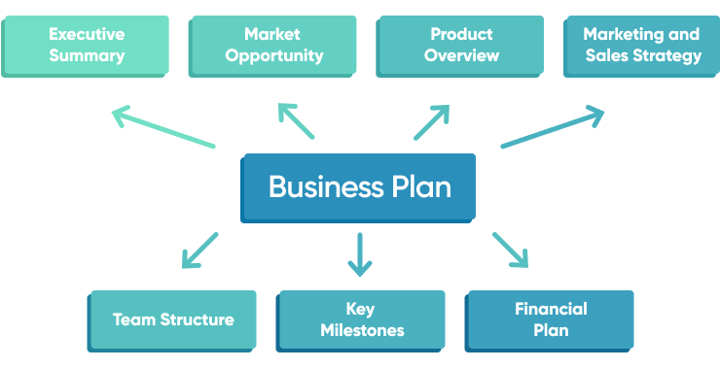
Business Plan

Slide 56
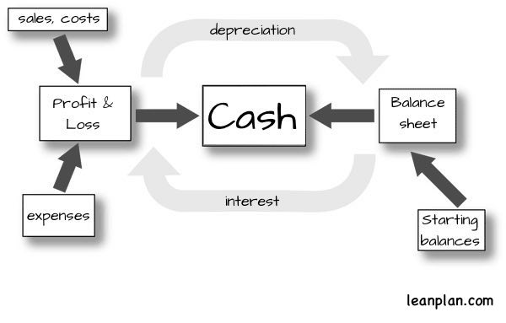
Financial projections

Slide 57
Overview of Valuations and Term Sheets
Valuation
The process of determining the economic value of a business or asset.
Term sheet
A non-binding agreement outlining the basic terms and conditions of a proposed investment.

Slide 58
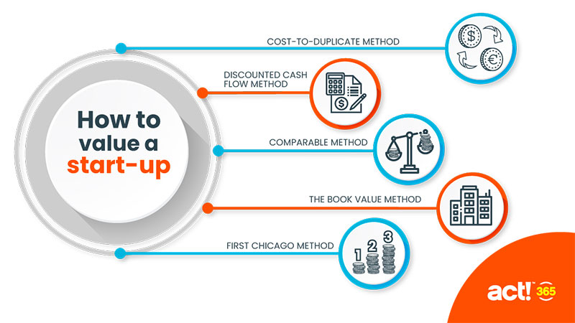
Valuation

Slide 59
Startup Valuations tools
High Tech Startup Valuation Estimator by Cayenne Consulting
Startup Valuation Calculator by EquityNet
Pre-Money and Post-money valuation calculator

Slide 60
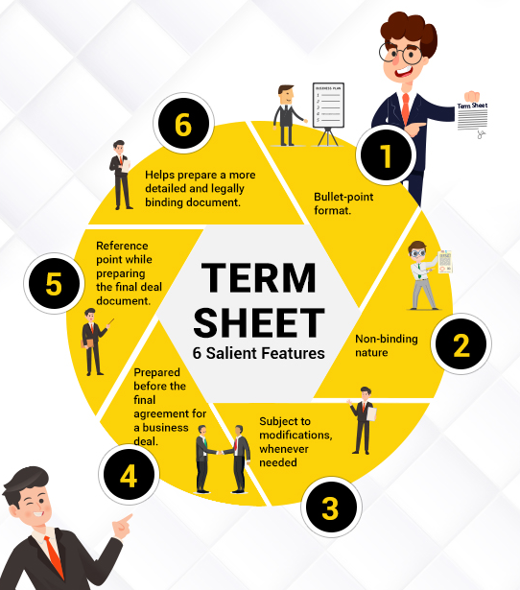
Term sheet
A term sheet is a non-binding document that outlines the basic terms and conditions of a proposed investment or financing deal.
It is typically used as a starting point for negotiations between parties and is meant to provide a summary of the key terms and conditions of the proposed deal.

Slide 61
Importance of Understanding Terms and Conditions
Understanding the terms and conditions of funding agreements is crucial for entrepreneurs to avoid misunderstandings and ensure they receive the funding they need.
Key terms to focus on include valuation, equity ownership, board representation, and liquidation preferences.

Slide 62
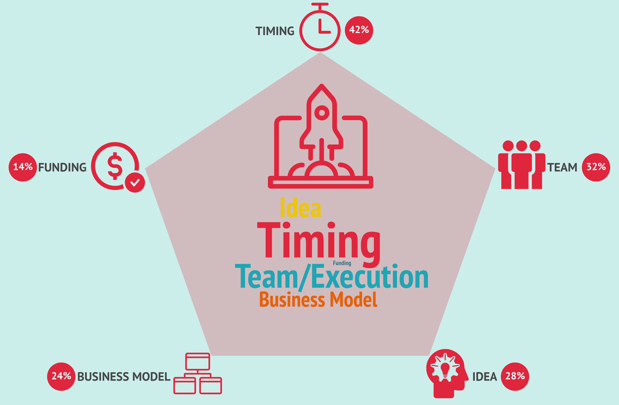
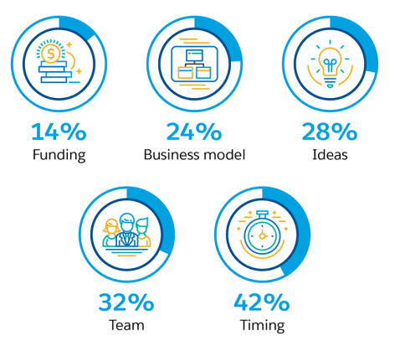
Factors that Contributed to Success
Strong leadership
Innovative products or services
Market timing

Slide 63
Incubators and Accelerators

Slide 64
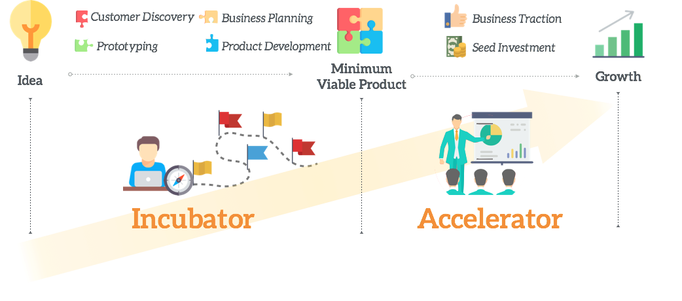
Incubators and Accelerators

Slide 65
Incubators and Accelerators
Incubators and accelerators are programs designed to support early-stage startups and help them grow and succeed.
Incubators focus on nurturing startups in their early stages, while accelerators provide a more structured program with a fixed duration and a focus on scaling.

Slide 66
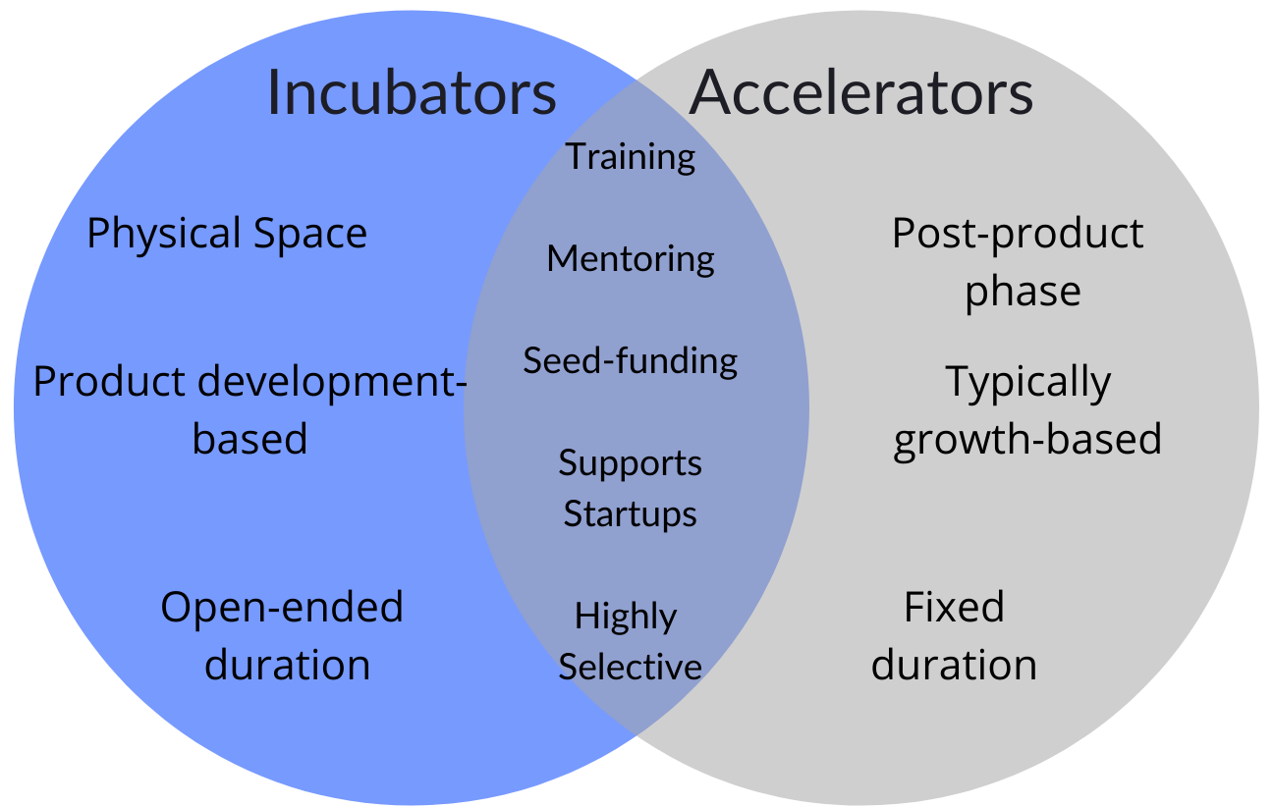
Incubators and Accelerators
Incubators focus on nurturing startups in their early stages
Accelerators provide a more structured program with a fixed duration and a focus on scaling.

Slide 67
Types of Incubators and Accelerators
Incubators:
University-based incubators
Independent incubators
Corporate incubators
Accelerators:
General accelerators
Sector-specific accelerators (e.g., fintech, healthtech)
Corporate accelerators

Slide 68
Benefits of Incubators and Accelerators
Access to resources
Incubators and accelerators provide startups with access to resources such as office space, mentorship, networking opportunities, and funding.
Guidance and support
Startups receive guidance and support from experienced entrepreneurs, investors, and industry experts.
Focus and accountability
Incubators and accelerators provide a structured environment that helps startups stay focused and accountable.

Slide 69

Incubator and Accelerator Programs
Typical programs offered by incubators:
Business planning and strategy
Marketing and branding
Legal and regulatory compliance
Access to funding and finance
Typical programs offered by accelerators:
Mentorship and coaching
Workshops and training sessions
Pitching and presentation skills
Access to funding and investors

Slide 70
How to Choose the Right Incubator or Accelerator
Factors to Consider:
Focus
Location
Reputation
Resources
Mentorship
Networking
Funding
Program duration
Cost

Slide 71
How to Choose the Right Incubator or Accelerator
Questions to Ask:
What is the program's focus and mission?
What resources does the program offer, and how do they align with my startup's needs?
What is the reputation of the program, and what success stories can you share?
Who are the mentors and industry experts involved in the program?
What networking opportunities does the program offer?
Does the program provide funding or connections to investors?
What is the program's duration, and what milestones can I expect to achieve during that time?
What is the cost of participating in the program, and what equity or fees are involved?
How does the program support startups in scaling and growing their business?
What are the program's expectations for commitment and involvement from startup founders?

Slide 72
How to Choose the Right Incubator or Accelerator
Tips for Selecting the Best Incubator or Accelerator:
Research thoroughly
Network with other entrepreneurs
Look for a program that fits your stage
Consider the program's investment strategy
Evaluate the program's network
Look for a program that offers flexibility
Evaluate the program's track record
Look for a program that aligns with your values
Consider the program's location:

Slide 73
Examples of Successful Incubators and Accelerators
Incubators:
Y Combinator (Airbnb, Dropbox, Reddit)
500 Startups (Twilio, SendGrid, Intercom)
Techstars (SendGrid, Sphero, Fitbit)
Accelerators:
Accel (Dropbox, Facebook, Spotify)
KPCB (Google, Twitter, Uber)
Greylock (Airbnb, Facebook, LinkedIn)

Slide 74
Saudi Incubators and Accelerators
9/10ths
KAUST Innovation Fund
Riyadh Valley Company
Business Incubators and Accelerators Company
Taqadam
Badir Program
Falak Business Hub
Nomow Incubator
SURE International Technology
Startups House
Wa'ed
Wadi Makkah

Slide 75

Example
ArabiaWeather is a weather forecasting and environmental monitoring platform that was founded in 2010 in Riyadh, Saudi Arabia.
The platform provides accurate and localized weather forecasts, as well as environmental monitoring services, to individuals, businesses, and government agencies across the Middle East and North Africa.

Slide 76
ArabiaWeather
Incubator/Accelerator: Badir Program
ArabiaWeather was incubated at the Badir Program
Badir Program provided access to resources, mentorship, and funding.
Impact:
ArabiaWeather's has raised over $10 million in funding from investors, including a $5 million Series A round led by Saudi Arabia's National Technology Development Program.
The platform has helped to raise awareness about environmental issues and promote sustainability, and it has also provided critical weather forecasting services to help protect people and property during extreme weather events.

Slide 77
ArabiaWeather
Lessons Learned:
It highlights the importance of incubators and accelerators in supporting early-stage startups.
These programs can provide valuable resources, mentorship, and connections that can help startups to scale and achieve success.
Saudi Arabia can achieve global success by addressing local needs and challenges.
The company's focus on providing accurate and localized weather forecasts has helped it to differentiate itself from international competitors and establish a strong presence in the region.

